Slide 1
Getting started with SharePoint Framework
Introducing SharePoint Framework
Notes:
Source of external slides: Ignite 2017 – Dan Kogan
https://myignite.microsoft.com/sessions/55144

Slide 2
Agenda
Evolution of SharePoint User Interface
Overview on SharePoint Framework
Demo
Q&A

Slide 3


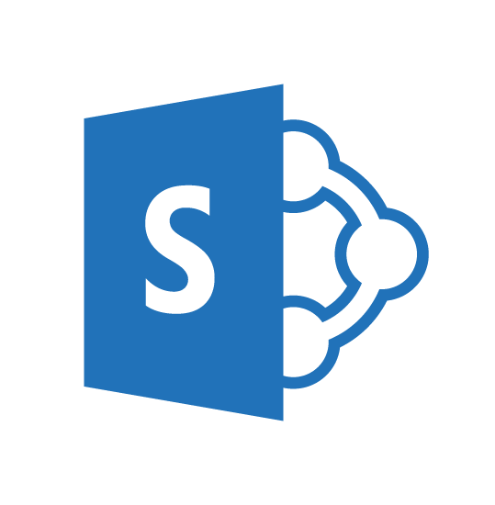
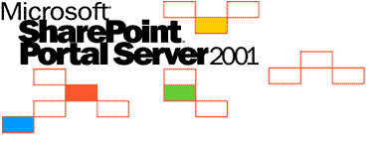
SharePoint UX – Evolving cross versions
SharePoint
Portal Server 2001
SharePoint
Portal Server 2003
Office SharePoint
Server 2007
SharePoint
Server 2010
SharePoint
Server 2013
SharePoint
Server 2016, SPO
2001
2003
2006
2009
2012
2016 …
ASP
Early Server Widget Tech
Single Box
ASP.NET
WebParts
CAML
SharePoint Publishing
FAST acquisition
Shared Services (e.g. taxonomy)
First Client Side Rendering Using XSL
Search driven publishing sites
Client Side Rendering sprinkled in, e.g. CBS, MDS, etc.
Hybrid
Modern standalone cloud apps, e.g. O365 Video, Delve, etc.
…
SPFx and Office Fabric
Modern SharePoint pages
Notes:
Tahoe/SPS 2001 – ASP Based, Single Box
SP 2003 – Moved to ASP.NET, scale out, enterprise manageability
SP 2007 – Added ECM, Publishing, Shared Services
SP 2010 – FAST acquisition, search driven portals, scaled up doclibs
SP 2013 – Multitenant, base for our cloud based release
SP 2016 – First version migrated back from Cloud

Slide 4
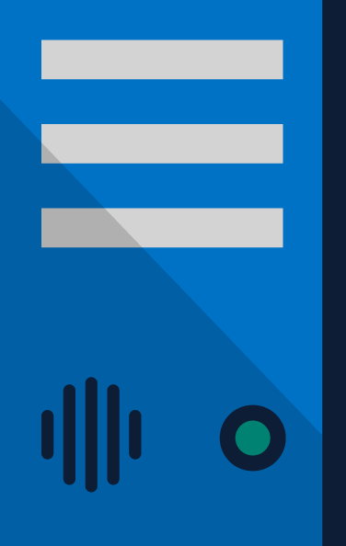
SharePoint Extensibility Principles Build long-term, value-added services for enterprise mobility
Principles
To provide an Application Development Framework that aligns 1st and 3rd parties
To build industry leading client side solutions On-Premises and in the Cloud
Unlocking the potentials of SharePoint and the Microsoft Graph on desktops or any device
Notes:
Over the past several years, with the evolution of Office 365, development of SharePoint solutions has encountered a new set of challenges: while on one hand IT and Tenant administrators require a new set of tools to control how data get accessed and consumed in their tenancies, developers, on the other hand, want to programmatically control the whole lifecycle, experience, and data access capabilities of a Site.
Unfortunately, developers today find themselves constraint around building app parts as a result of iFrames, a reduced set of APIs, and no integration with cross Office 365 workloads. This in turn limits their ability to develop powerful portals that extend SharePoint.
The client-side development framework will deliver capabilities that will help both first party and third party developers build powerful, rich applications and provide an enjoyable web experience in Office 365 for end users that are both intuitive and simple to consume.

Slide 5
SharePoint as an Enterprise Development Platform
User experience
Data and APIs
Processes
Packaging, deployment, and store
SharePoint Framework (SPFx)
PowerApps
Add-in parts & custom actions
Graph APIs
Client Object Model (CSOM+JSOM)
REST
Files API
Webhooks
Microsoft Flow
Workflows
Remote event receivers
SPFx client side solutions
Add-ins and SharePoint Store
Declarative solutions

Slide 6
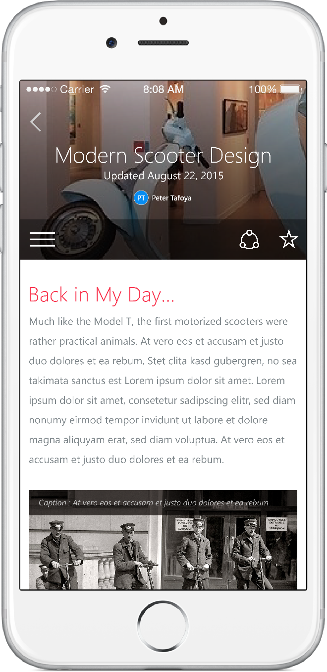
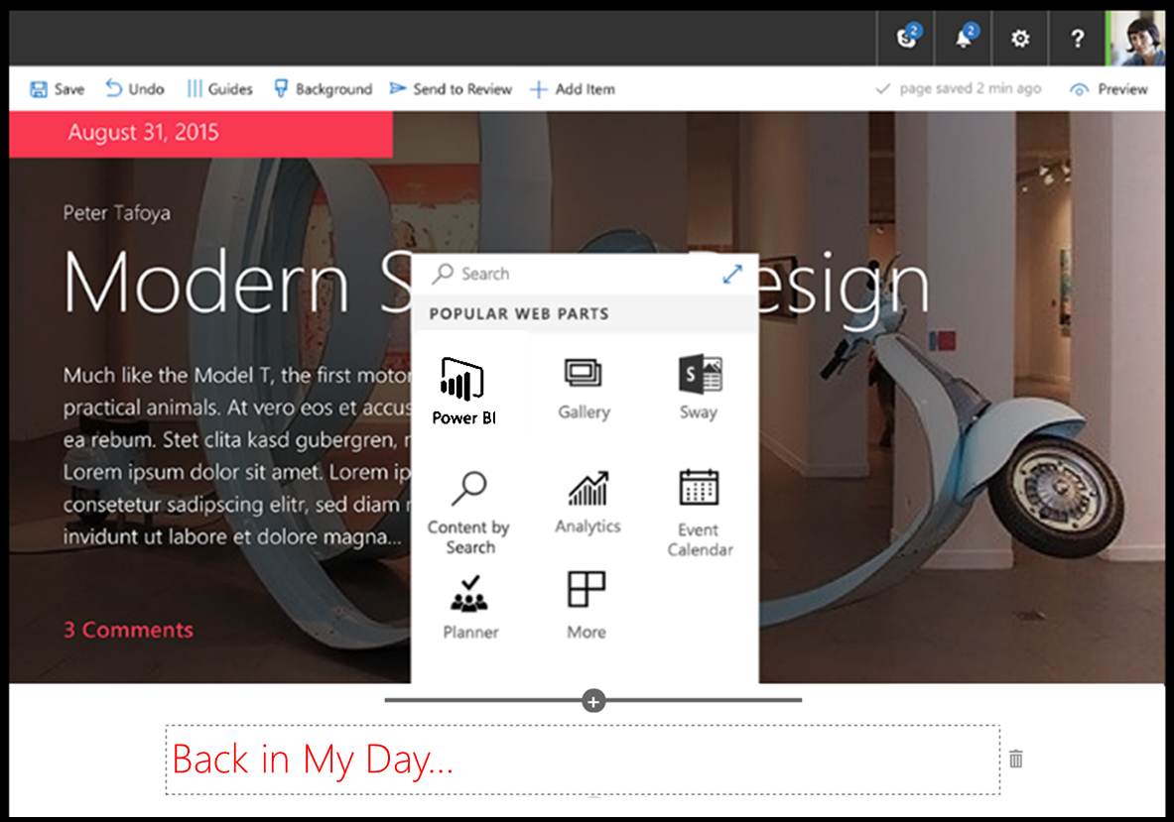
SharePoint Framework
Modern client-side development
Lightweight web and mobile
Powers our own experiences
Backward compatible
Supports open source tools and JavaScript web frameworks
SharePoint framework
Microsoft Graph
LOB Systems and Cloud Services
Notes:
Built into the SharePoint mobile apps

Slide 7
SPFx rapid release cadence
Sept 1, 2016
SPFx Drop 2
Sept 21, 2016
SPFx Drop 4
Nov 22, 2016
SPFx Drop 6
Feb 23, 2017
SPFx GA
Aug 29, 2017
SPFx Extensions RC0
Aug 9, 2017
Tenant Admin Deployment
Aug 17, 2016
SPFx Drop 1
Sept 14, 2016
SPFx Drop 3
Oct 17, 2016
SPFx Drop 5
Jan 9, 2017
SPFx RC0
June 12, 2017
SPFx Extensions Preview
Sept 12, 2017
FP2 for SP2016 (SPFx for on-prem)
Client side web parts
Modern tool box integration
Responsive by design
CDN Support
Front end development tool chain
Compatibility with classic pages
Workbench
Property panel
APIs
Samples
Documentation
Package deployment and app catalog integration
Shipped since last Ignite!!!

Slide 8
What’s a modern page?
Client-side rendered
Natively responsive
Client-side web parts
Client-side and persisted caches
Mobile optimized
Notes:
Client-side rendered using Open Source web tech, predominantly React and Office Fabric
CDN deployed “single-page” web apps with client side interactivity and fast page routing
Client-side web parts
Client-side and persisted caches
Mobile optimized (responsive)

Slide 9
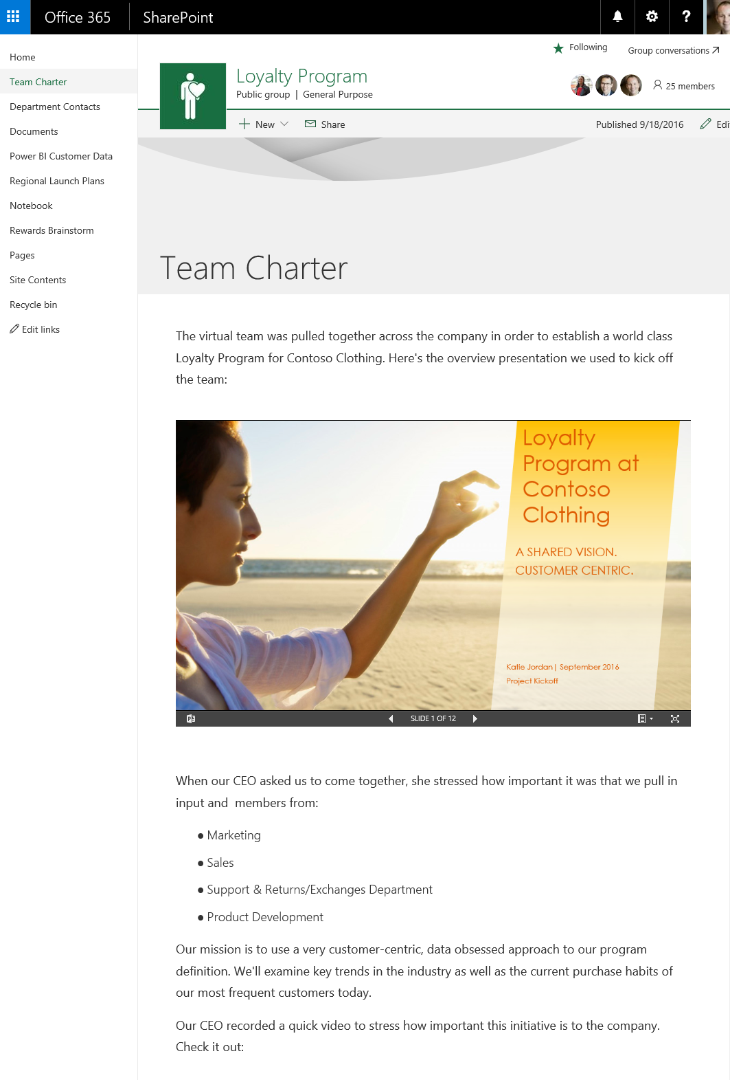
Modern Site Pages
Easily create powerful, beautiful looking pages
Communicate ideas and information using our new authoring canvas and gallery of web parts.
Modern building blocks
Authoring canvas and web parts are built using client-side HTML and JavaScript. Pages are reusable in custom applications
Mobile support is built in from the start
Content reflows across device sizes and pages are fast and fluid.
Pages get better with the Microsoft Graph
Authors can leverage Microsoft Graph to surface relevant pages to the people that need to read them.

Slide 10
Out of the box

Slide 11
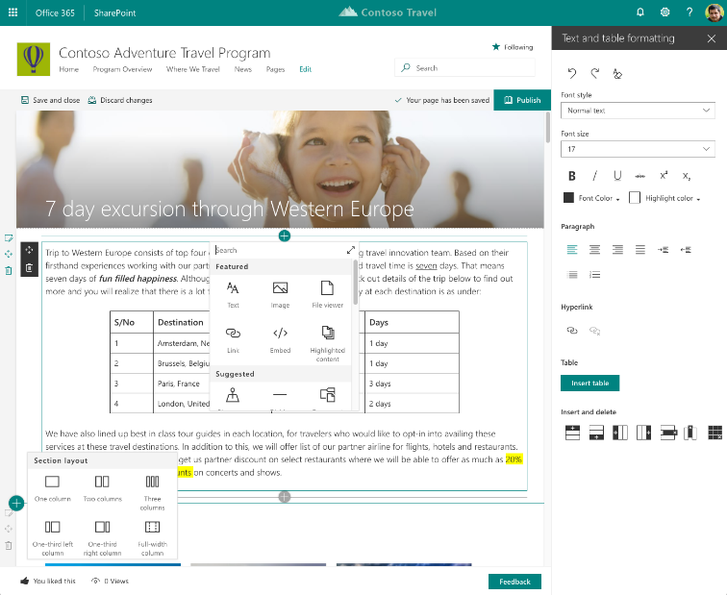
Easily create powerful, beautiful looking pages
Authoring
WYSIWYG authoring
Multi-column sections
Drag/ drop editing
RTE & Paste support
OOB web parts
Page Templates

Slide 12
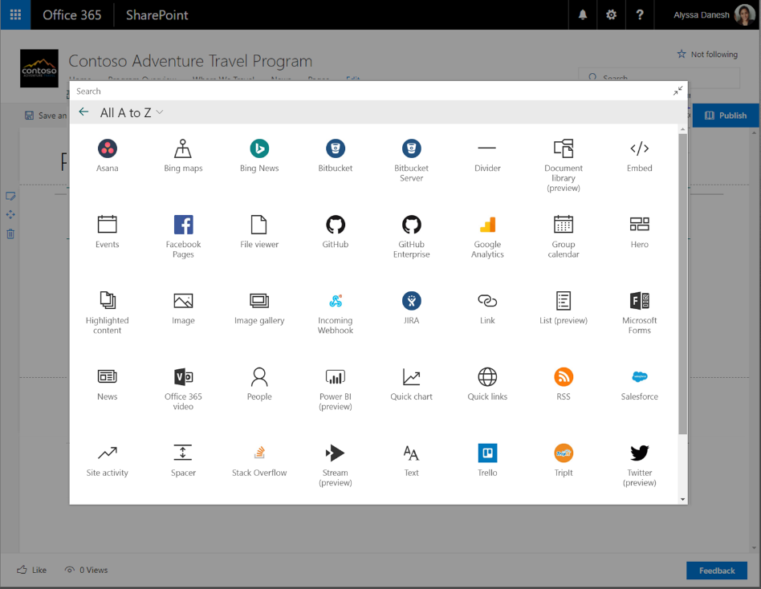
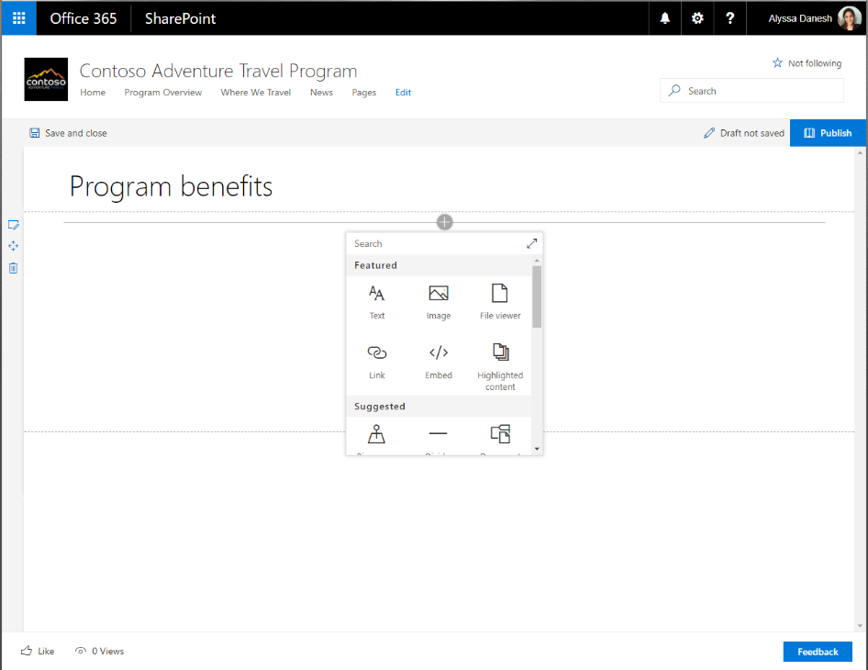
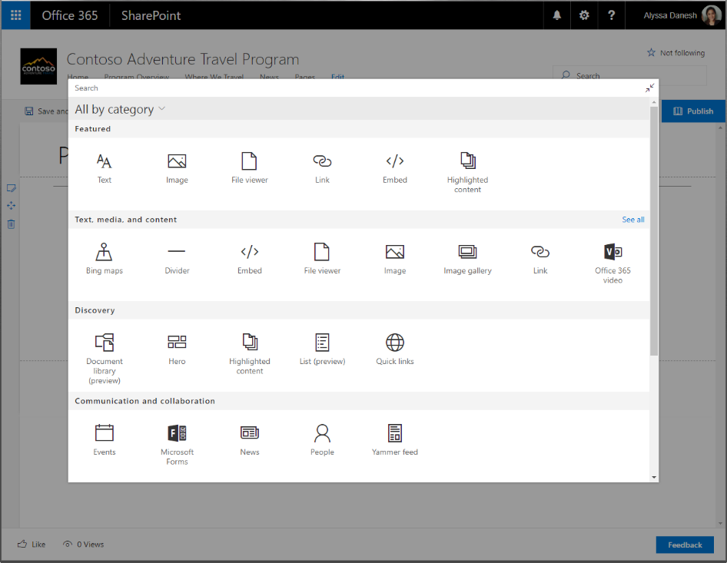
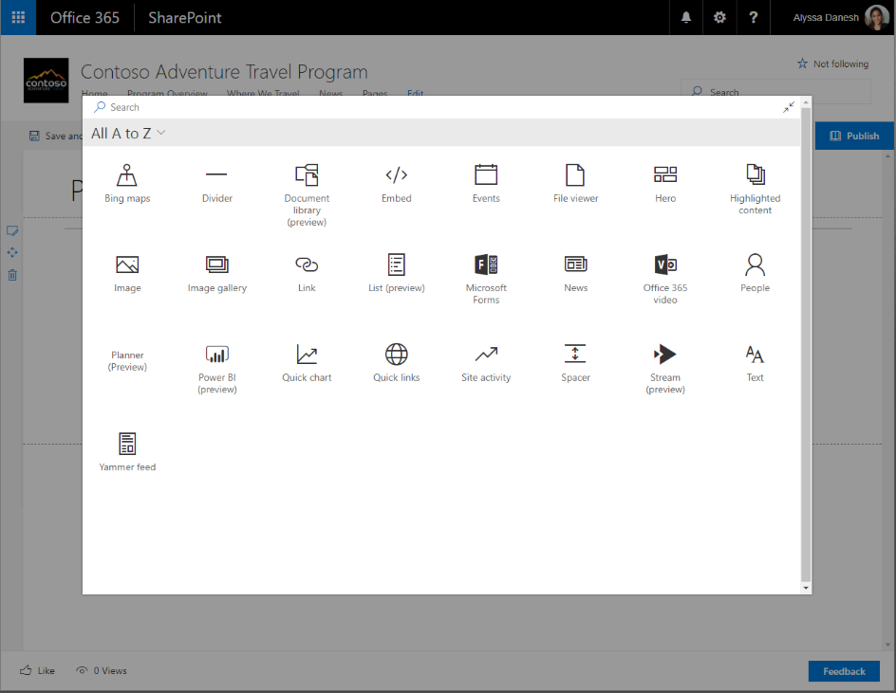
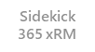
Web Parts and Toolbox
Large Tool Box
Search
Sort by Group or Alpha
Includes Connectors
Includes SharePoint Add-ins

Slide 13
Is all SP Online development in JavaScript?
In similar ways as with SharePoint Add-in model, server side development is needed for back end services
No
SharePoint Framework concentrates on user interface, not on fundamentals around the API usage

Slide 14
DEMO
Modern SharePoint pages and experience with out-of-the-box web parts
Notes:
Review demo site and look at modern webparts – ootb – links and sections
https://dev365x810645.sharepoint.com/sites/onlinemarketing

Slide 15
Agenda
Evolution of SharePoint User Interface
Overview on SharePoint Framework
Demo
Q&A

Slide 16
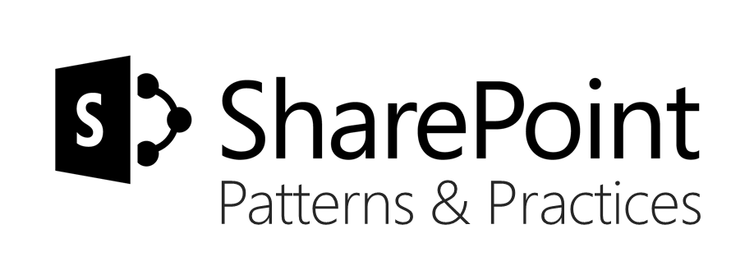
Sharing is caring…
Code samples and solutions
Reusable components
Guidance documentation
Monthly community calls
SharePoint Framework
SharePoint add-ins
Microsoft Graph
Office 365 APIs
http://aka.ms/SharePointPnP

Slide 17

Q&A

Slide 18


